Slide 1
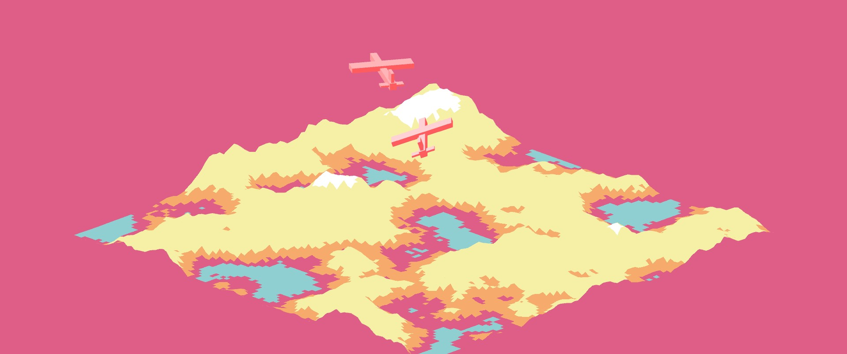
Come Fly With Me
Tom Doyle - z5164445

Slide 2
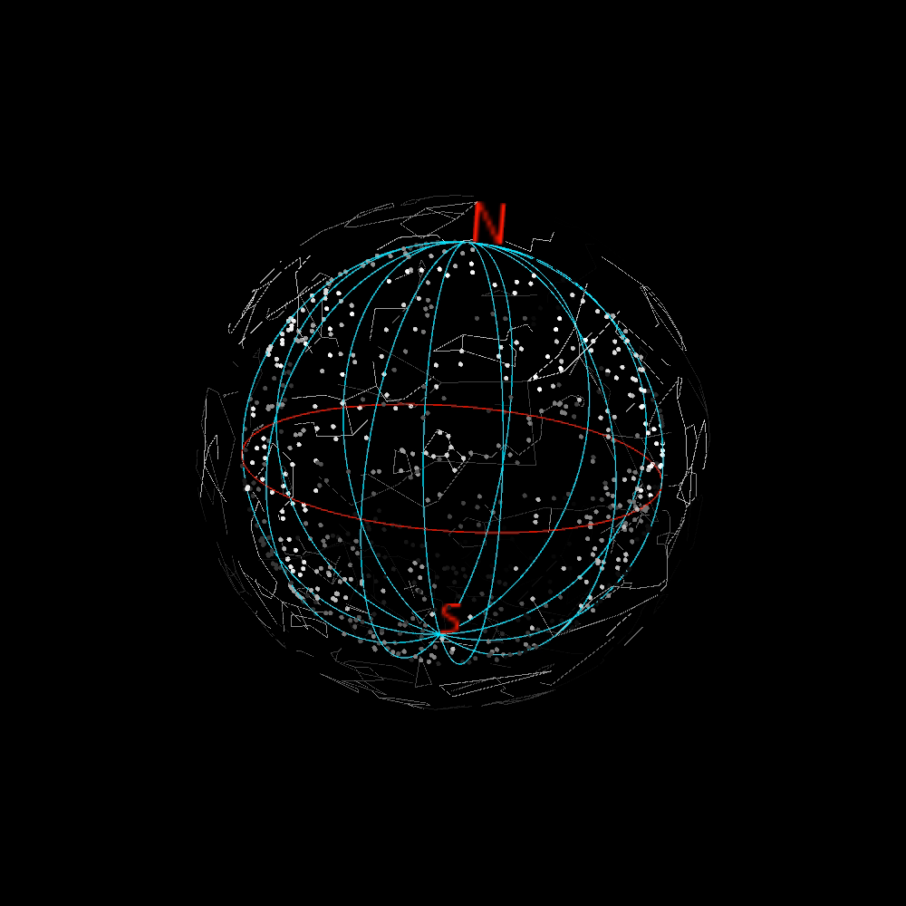
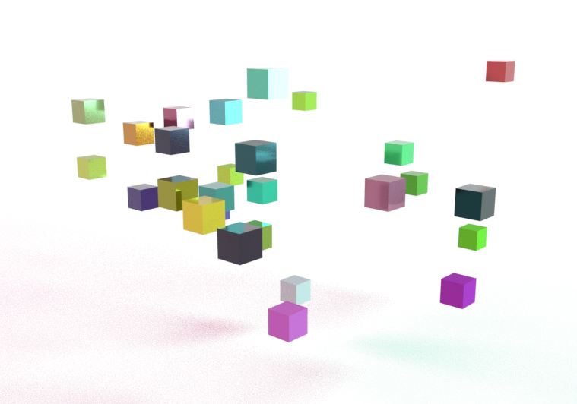
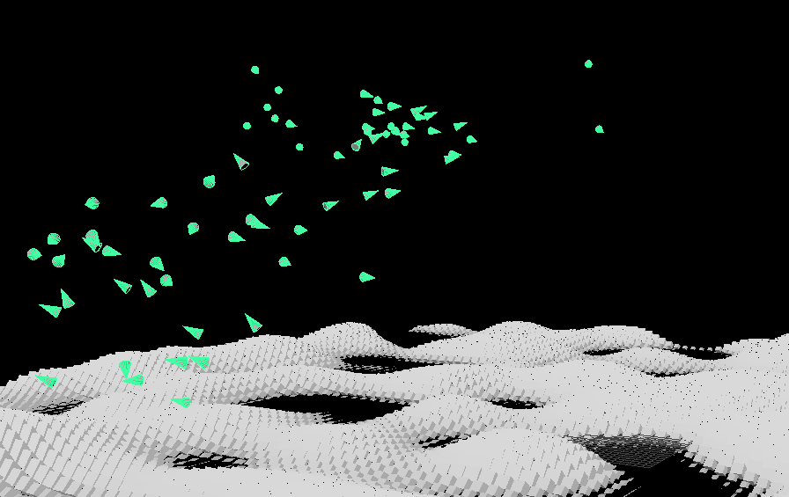
Experiments
My practice-led research has aimed at exploring the natural through simulation. I have explored a range of concepts using varying software and approaches.

Slide 3
Amendments: Previously little to no direct user interaction:
The past few weeks have been focused on finding an appropriate solution and software that is both capable of:
Immediate Feedback and User Interactivity, such as Processing
Intuitive 3D Rendering, preferably with a Graphical User Interface (GUI), such as Maya
Able to export to an executable File for portability and ease of Installation.
I decided to build my final project using Unity.

Slide 4
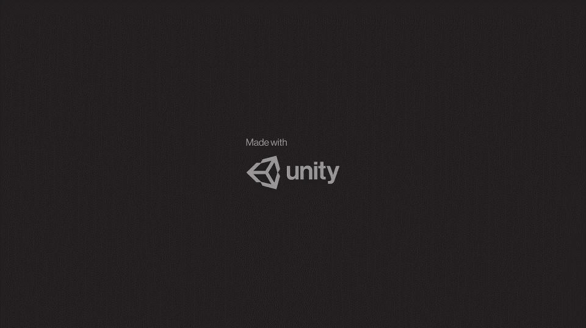
Demo

Slide 5
Come Fly With ME
Interactive Audio/Visual Work.
A participant controls a plane in order to catch glimpses of accompanying planes and the various sounds they produce.
Generative/Simulated

Slide 6

Technical/Creative Decisions
Technical
Skeleton Tracking: Position of a user’s hands are tracked. The angle between the participant’s hands will simulate the roll of the aircraft. If the hands are not far apart enough, the plane will not roll, and a visual will pop up.
Gentle Flocking: Adding in more than one attracting force for the planes made them line up too quickly, so I decided that they would only slightly move towards the centre of the flock.
Low-Poly Models: During testing, things didn’t run smoothly on a large terrain, so I tried to tastefully minimize the terrain. Upon export, I just liked the look, and carried the design to the planes.
Creative
Why Planes? The planes were originally going to be birds, but upon testing people would be constantly flapping their arms. If they stopped flapping, I would have to let the bird plummet.
Music: Max would have been nice in retrospect, but despite not being a musician, all the sounds, being two pianos, a strings section and Kick/Hi hat combo, were the pinnacle of my composing career.
Colours: Being my own creation, a stylized colour palette seems like a liberty I am entitled to, and heightens the abstract nature of the work.

Slide 7
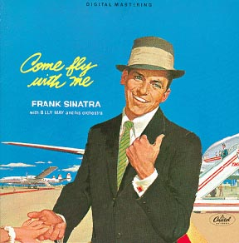
Decisions continued.
Flight: Adds to a sense of Freedom within the world. Grants a sense of power to the audience. The outstretched arms inadvertently emit a sense of nostalgic playfulness.
Speed: Your plane can’t match the speed of other planes, leaving the participant in desperate attempt to avoid being left alone.
Come Fly With Me: Frank Sinatra, 1958. Often this period is associated with Utopic visions and sense of optimistic wonder.

Slide 8
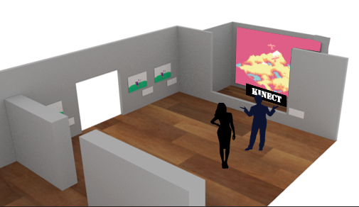
Space

Slide 9
Reflection
No real world Data input
Data I had planned on using no longer lent itself to the final project’s theme.
I am happy with the current state of user input.
C# and Unity needed more time to learn:
A Result of pivoting my idea last second, poor communication.

Slide 10

Time Line
Planned TimeLine
Week 10 |  |  |  |  |  |  | Week 11
Monday | Tuesday | Wednesday | Thursday | Friday | Saturday | Sunday | Monday | Tuesday | Wednesday | Thursday | Friday
Kinect Setup |  | Terrain Setup |  |  | Boid setup |  | Musical elements |  |  | Presentation setup
Actual TimeLine
Week 10 |  |  |  |  |  |  | Week 11
Monday | Tuesday | Wednesday | Thursday | Friday | Saturday | Sunday | Monday | Tuesday | Wednesday | Thursday | Friday
Kinect Setup |  | Terrain Setup |  |  | Boid setup |  | Boid debugging

Slide 11
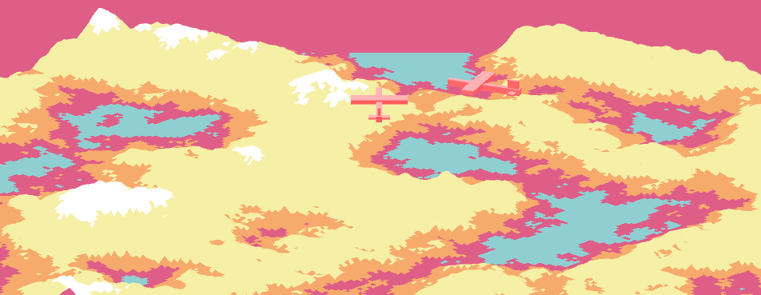
Future Direction
Implementations of other assets: e.g. Ground elements, wildlife, water
MultiUser: Add a plane for each Skeleton being tracked/ perhaps a split screen mode.
Would need to consider the sounds applied to each user Plane.
Music: More than two chords would detract from the musical repetitiveness.
Mobile: Would work well with Gyroscopic Controls. Reminiscent of old school retro handheld video games.
Gallery Space: Would be nice to eventually show the work.

Slide 12
Q & A

